Slide 1
Linguistic Feature-Based Model for Fake News Detection and Classification
Team: Arnav Santosh Nair, Hardik Harti

Slide 2
Review - 1: Paper

Slide 3
Objective:
To create a linguistic feature-driven deep learning model for effective fake news detection and to measure the impact of extracted linguistic features based on the comparative outcome with the deep learning model.

Slide 4
Neural Networks
Basic DL architecture that uses hidden layers and activations to learn more complex functions.
As each activation unit is computed using all units from the previous layer, the final output can represent very complex functions that ML algos may not be capable of learning.
Due to much larger number of parameters, more prone to overfitting and hence requires much larger amount of data for proper training.

Slide 5
Paper Understanding
The paper highlights an approach that provides better results than simply running the input data through even a powerful LSTM-based model. The approach involves first extracting certain linguistic features from the data, then inputting these features into a sequence model. These features were chosen as the literature suggests that they provide keen insights into the authenticity of the data, and thus behave as a compact guide to discerning real news from fake news.
While the first 3 classes of features are commonly used with Neural Networks for NLP tasks, the final class is less-used and this paper provides supporting proof of its efficacy for tasks of this nature.
The 4 classes of linguistic features used are:

Slide 6
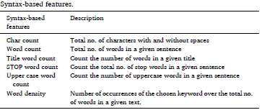
Syntax-Based Features

Slide 7
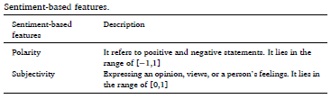
Sentiment-Based Features

Slide 8
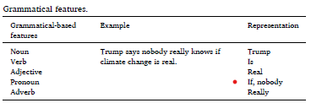
Grammatical Features

Slide 9
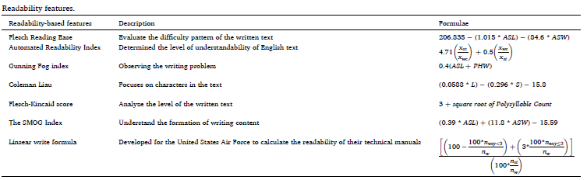
Readability Features

Slide 10
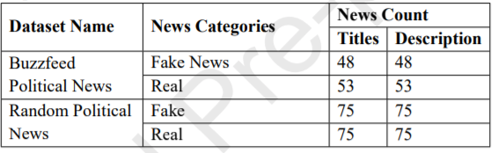
Dataset Used
Two popular datasets have been used for this task. They are:

Slide 11
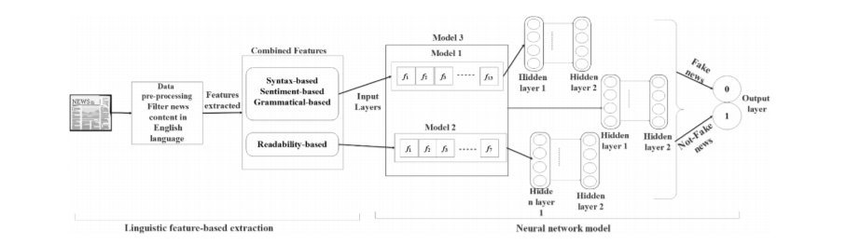
Application Model

Slide 12
Application Flow of Logic
The first step involves sending the dataset into the preprocessing stage.
In data pre-processing, the dataset will begin by tokenizing and removing all punctuations. This pre-processed data is now ready for feature extraction.
The next stage extracts the aforementioned linguistic features, to be sent into the model.
Stage 3 involves the actual Neural Network architecture that will accept the extracted features and run them to perform the classification.
A break-down of the various components of this model are detailed in the following slides.

Slide 13
Model 1
Model 2
This will evaluate the the three important types of linguistic features: Syntax based, Sentiment based and Grammatical evidence features. The feature extraction stage has been set up to extract a total of 13 features from these feature classes. Thus, Model 1 works on this feature set
This will evaluate the readability features, consisting of a total of 6 features from the extraction stage.

Slide 14
Model 3
This model behaves as a superset of the ones discussed so far. It works on all 19 features extracted from all the different feature classes, so as to obtain a holistic look at the input data. Thus, it works with 19-dimensional feature vectors.

Slide 15
Model Architecture
The Neural network architecture is the same for all the models.
Every model has only 2 hidden layers, each with 4 units. These relatively smaller values are sufficient considering the number of features isn't extremely large.
The ReLu function will be used as the activation function at every hidden layer.
The final classification is obtained using a Softmax activation function.

Slide 16
Possibilities for Improvement
The output classification is performed onto 2 units(fake, non-fake) using a Softmax function. However, as this is a binary classification problem, it is worth investigating the performance of the model if we instead perform Sigmoid onto 1 output unit.
As the 3 models mentioned work in an interconnected manner, the process of hyperparameter tuning becomes more complex than if they were working independently. Thus, attempts at finding better performing hyperparameters, including number of layers and activation units, than the ones outlined in the paper, may prove beneficial.
The paper uses mean-squared error as the loss function to optimize the model. However, classification problems are generally optimized using binary cross-entropy loss. As the paper authors make no justification for their choice of the former, use of the latter for optimization may yield different(and possibly better) results.

Slide 17
Review - 2: Implementation

Slide 18
Fake News Dataset Used
The datasets used are the same as described in the paper:

Slide 19
Sentimental Features
Polarity: From -1 to 1
Sentiment Score or Subjective Score
Both these features were successfully extracted from the dataset.

Slide 20
Syntax-Based Features
Character Count
Word Count
Uppercase Word Count
Stop Word Count
Title Word Count
Lexical Density
All these features were successfully extracted.

Slide 21
Grammatical Features
Noun Count
Verb Count
Adjective Count
Pronoun Count
Adverb Count
All these features were successfully extracted.

Slide 22
Readability Features
Flesch Reading Ease
Automated Readability Index
Gunning Fog Index
Flesch-Kincaid Score
SMOG Index
Linsear Write Formula
All these features were successfully extracted.

Slide 23
Model Implementation
The first 3 feature classes were input to Model 1 with 3 Hidden Layers.
The Readability class of features was input to Model 2 with 3 Hidden Layers.
The entire feature set was input to Model 3 with 3 Hidden Layers.
The output activations of all 3 models were sent into output layers with the sigmoid activation that then produced the output activation for probability of fake news.
The performance of all 3 models are then compared to see the efficacy of each feature set for the given task.
Train-test split was performed at 80-20.
Binary Cross-Entropy Loss was used to obtain an estimate of the final performance of the model.

Slide 24
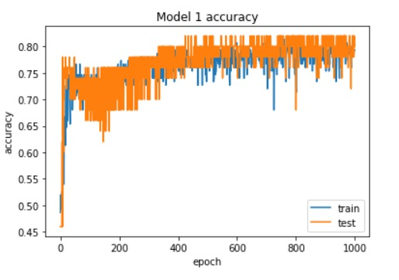
Results
Model 1:

Slide 25
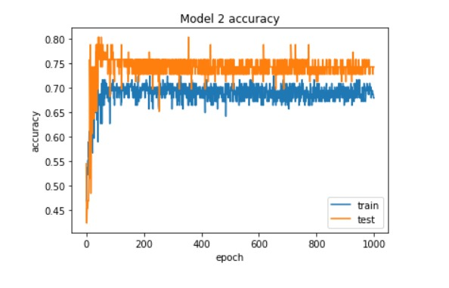
Results
Model 2:

Slide 26
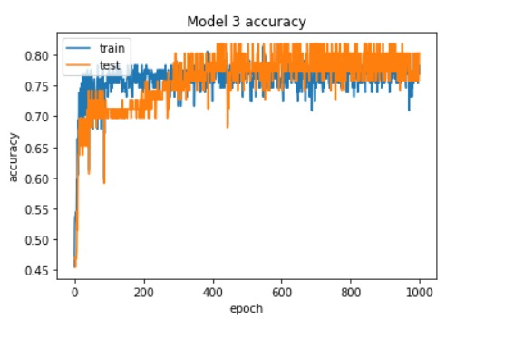
Results
Model 3:

Slide 27
Observations, Explanations and Conclusions
A common approach for such a task would be to send word embeddings of the input into an LSTM-based model and perform classification.
Instead, this paper aims to extract specific linguistic features from the input and use simple Sequential ANNs.
3 different features set were formed from the 4 feature classes extracted, each sent into a separate model, with the 3rd being a combination of the first 2.
After training and testing all 3 models, the 3rd model using the combined feature set produced the best performance on the given task, as indicated by the paper.
Thus, this unique approach of integrating Readability Features along with the other 3 commonly used Feature Classes seems to boost the performance of the model, supporting the validity of their use in tasks of this nature.

Slide 28
Comparative Study - I
While the aim of this paper was to compare only the 3 models mentioned before, we felt it necessary to compare with a different architecture all together, so as to establish the relative performance of this one.
The model chosen is Support Vector Machines(SVMs), the reason being:
a. As the number of features is relatively small, it can be assumed that the necessary hypothesis will not be too complicated and so, SVMs might be capable of handling this even though DL architectures generally outperform ML ones.
b. As this is a classification problem with very specific linguistic features, it is assumed that SVMs being large-margin classifiers can perform a sufficiently good job, thus making them a good candidate for comparison.

Slide 29
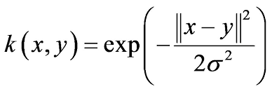
SVM Model - Architecture
SVM used for this study uses a non-linear kernel function so as to be able to produce more complicated non-linear hypotheses and decision boundaries.
The kernel function used is the Gaussian Radial Basis Function:
This models the boundary using a Gaussian Distribution Curve so as to determine the features of an input tuple.

Slide 30
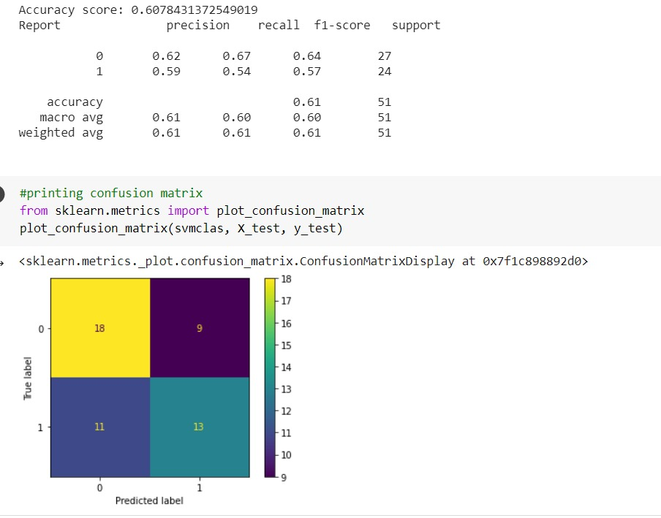
SVM Model - Performance

Slide 31
Comparative Inferences
The SVM model, despite the specific linguistic features and their relatively small number, is only able to achieve an accuracy of around 60%.
This indicates that despite its property of large-margin classification combined with the use of tailor-made features, it is unable to match the previous model in terms of performance.
This establishes a benchmark for the implemented model, setting it ahead of Machine Learning Classifiers even when the amount of data is less.
Additionally, NNs are still acceptable with large amounts of data while SVMs begin to become very computationally expensive. This further establishes the superiority of this model.

Slide 32
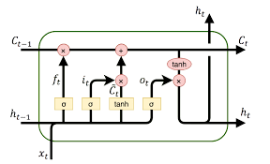
Comparative Study - II
While the previous comparison was with a theoretically inferior model, this one aims to put the model against a theoretically superior one in order to check its viability.
The model used here is Long Short-Term Memory(LSTM). It is the most powerful Sequence Models, obtained by taking the basic Recurrent Neural Network(RNN) and adding 3 gates so as to improve its ability to handle long-range dependencies.
It is the foremost model in the literature for sequence-input based tasks such as this, outside of Transformer-based architectures.

Slide 33
LSTM Model - Architecture
The pre-processing of data involves:
a. Tokenization
b. Padding the sequences
c. Encoding
These sequences are now sent into the LSTM-based model, which consists of the following layers:
a. Embedding - Produces and trains word embeddings to more dynamically represent the data and establish better relations between words. Can take pre-trained embeddings obtained from Word2Vec, GloVe, etc.

Slide 34
LSTM Model - Architecture(Contd.)
b. LSTM - This layer accepts the sequence embeddings and runs them through the LSTM cells, producing a 128-unit output activation.
c. Dense - This layer accepts the LSTM activations and performs the regular ANN activation with ReLu function.
d. Output - This layer performs sigmoid activation onto a single neuron.
Binary Cross-Entropy was used as the Loss Function.
Adam Optimizer was used for the optimization process.

Slide 35
LSTM Model - Performance and Inferences
The model obtained a final performance of around 70%.
Some potential explanations are:
a. Due to the relatively small amount of data, the LSTM couldn't sufficiently train its massive number of coefficients.
b. As the word embeddings used are trained alongside the weights, the model likely cannot learn good embeddings, curbing its performance.
Thus, our Sequential ANN model is more flexible and is able to outperform the advanced LSTM model in this particular setting of constrained data.

Slide 36
Possible Future Improvements
The training set performance of all 3 models leaves room for improvement. Thus, high bias could be a possible issue here.
Three ways to tackle this are:
a. Find more linguistic features for the model.
b. Create an integrated model with features other than linguistics
c. Increase the complexity of the model(number of layers, number of activations, etc.) so as to increase the complexity of the resultant hypothesis used.
On the other hand, train and test set performances are not too far apart, indicating that there may be a slight tendency to overfit, since both train and test sets come from the same distribution. Some solutions for this are:
a. Dropout - Not likely to help as number of activations is already very low.
b. Larger Training Set - May help reduce the variance in the model.

Slide 37
THANK YOU

